Slide 1
Wannabe Human
Team 5
김나영 박지윤
정상민 최주희

Slide 2
0
Index
1
Game Introduction
2
Development
3
Play Video
1-1. Game Overview
1-2. How to Play
1-3. Character
1-4. Collecting Time
1-5. Quiz Time
2-1. Team Introduction
2-2. Collecting Time
2-3. Quiz Time
2-4. Network
3-1. Game Play

Slide 3
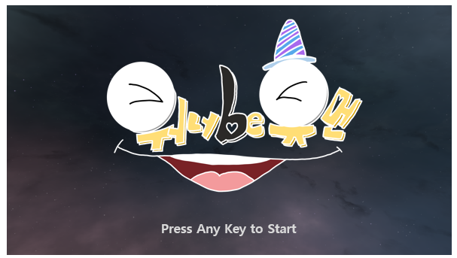
1
Game Introduction
1-1. Game Overview
Story
K-Monsters living on K-Planet happened to know
about the existence of the Earth and humans.
That’s how K-Monsters yearned for the Earth
and wanted to be human!
One day, K-Monsters accepted the offer of transcendental being
to make them become humans.
They took a spaceship and land on an isolated island where various training programs are prepared to become a human.
K-Monsters struggle hard to get out of the world…
Item | Content
Title | Wannabe Human
Platform | PC(Windows)
Genre | Multi, Quiz, Casual
Target | Anyone who wants to play a game with friends, family or boy/girlfriend
Description | Collect items and describe a word with them
Development environment | Unity, C#, Photon Network

Slide 4
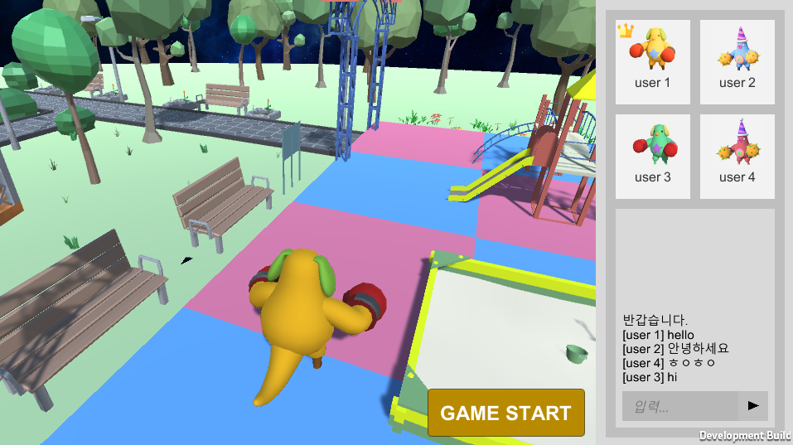
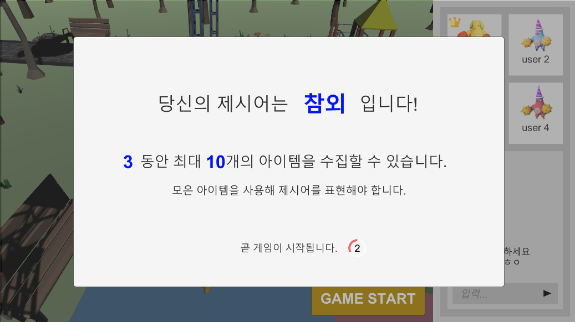
1
Game Introduction
1-2. How to Play
01
02
Gather 4 player in the lobby
Check the word that you will express

Slide 5
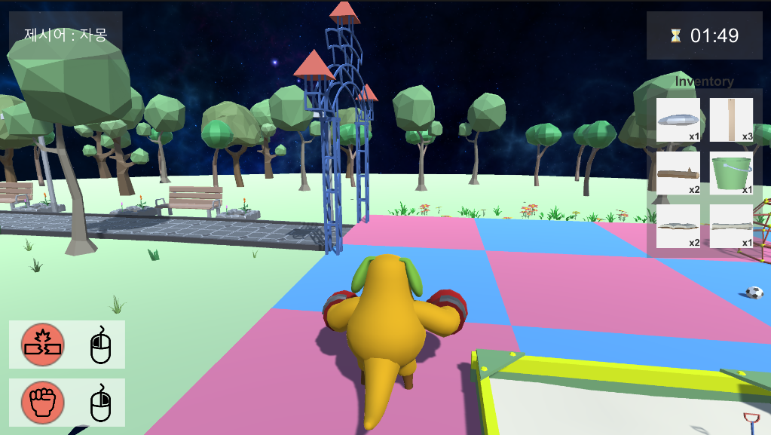
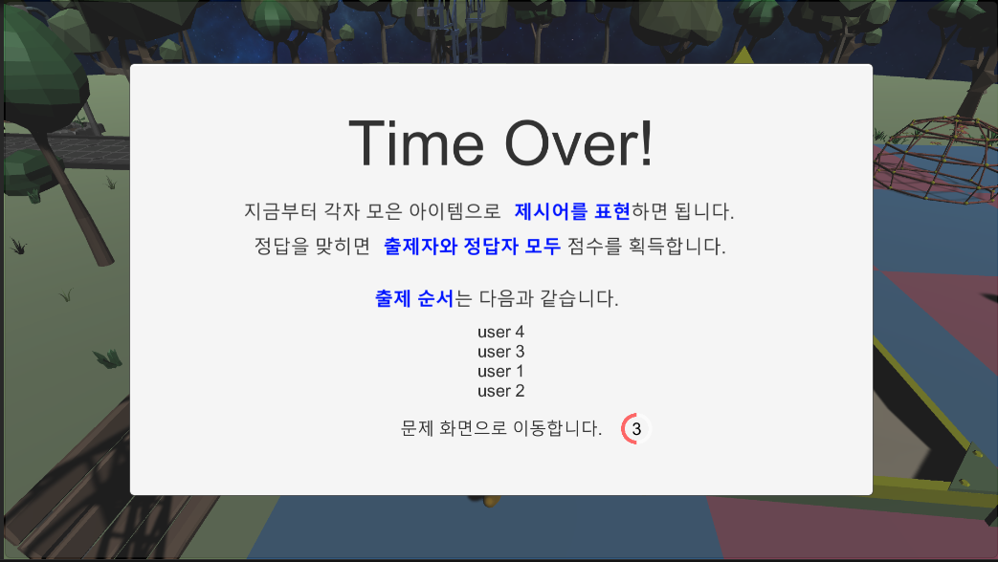
1
Game Introduction
1-2. How to Play
03
04
Destroy the objects on the map and collect items
When the collecting time is over, the quiz time starts
맵의 오브젝트를 부수며 아이템을 수집함

Slide 6
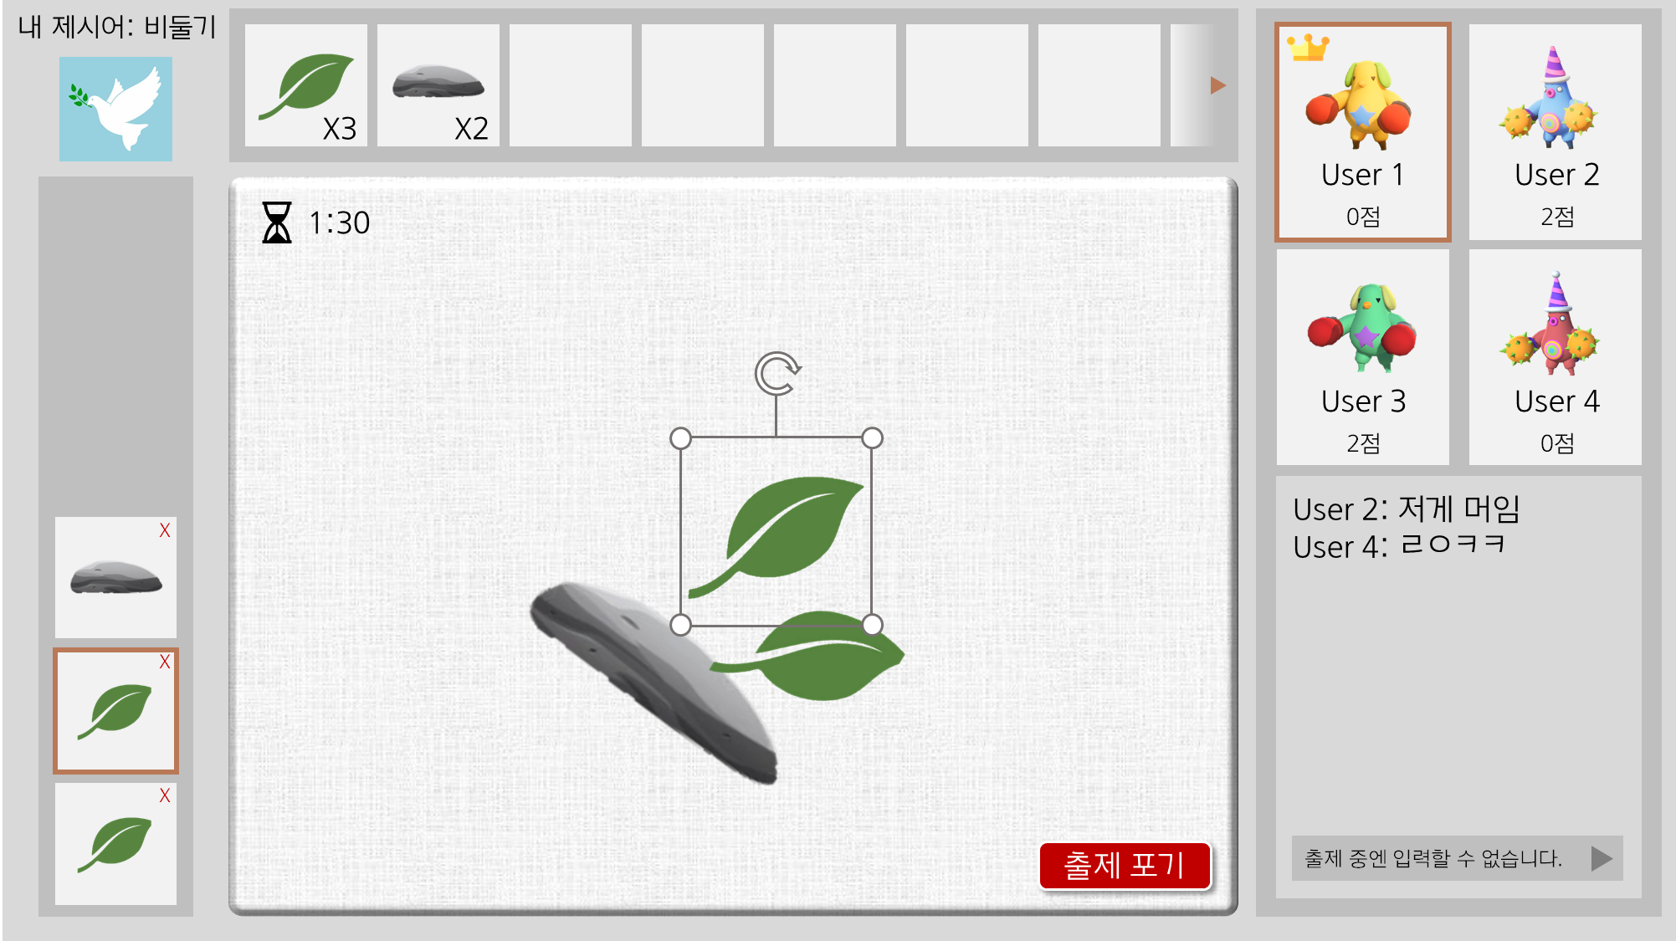
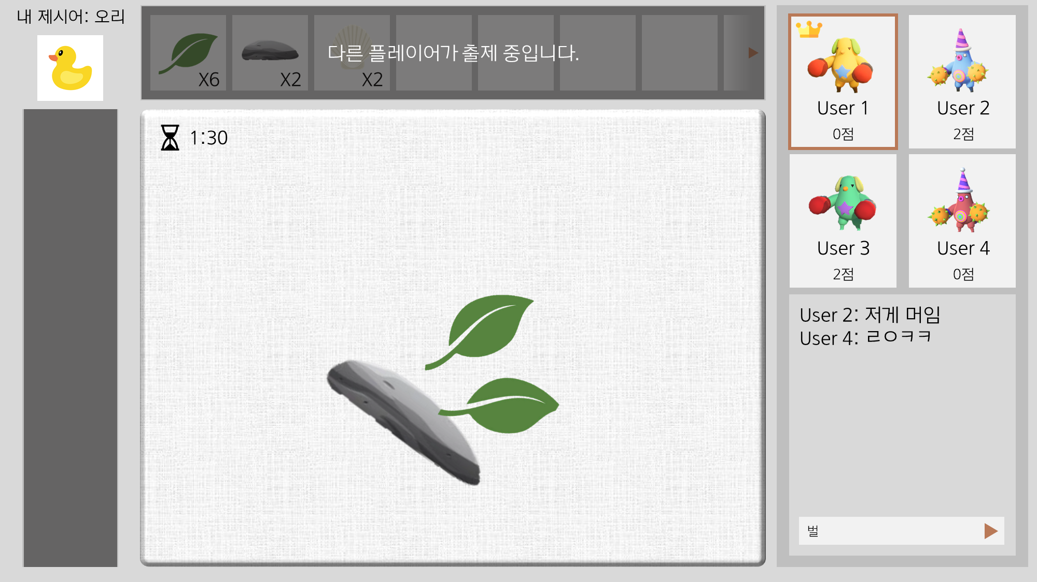
1
Game Introduction
1-2. How to Play
05
06
If it’s your turn, you should describe your word
with the items you collected
Others guess your word and type it in through chat
맵의 오브젝트를 부수며 아이템을 수집함

Slide 7
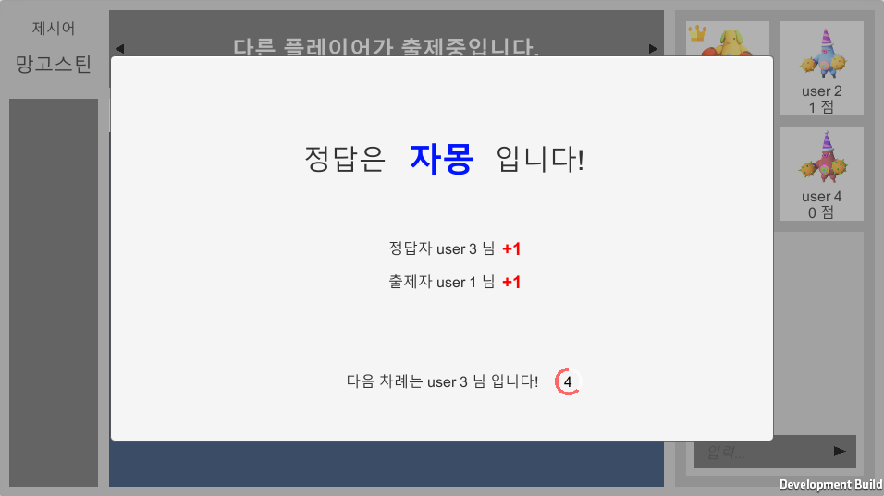
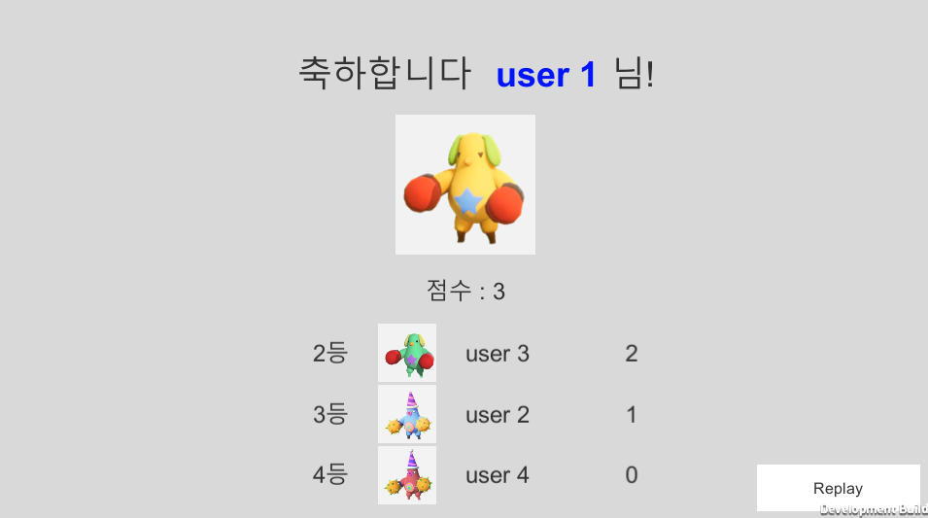
1
Game Introduction
1-2. How to Play
07
08
If a player guess the word correctly,
both the questioner and the player get points
After all players’ turns over,
the player with highest score wins
맵의 오브젝트를 부수며 아이템을 수집함

Slide 8
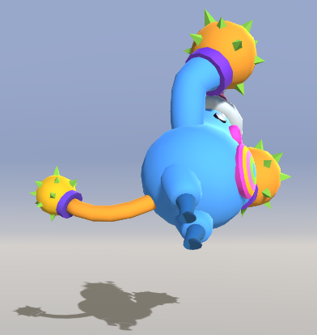
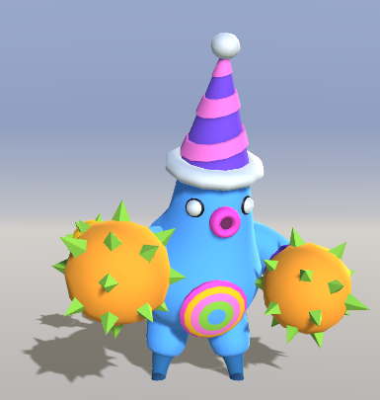
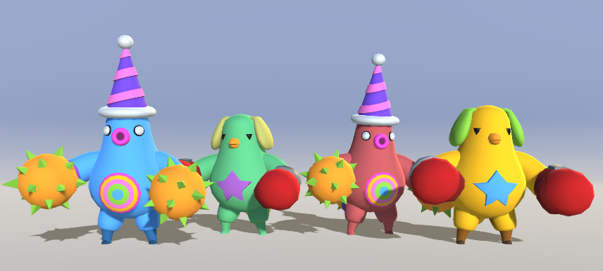
1
Game Introduction
1-3. Character
Kick
Punch
Character
Each player’s character is
colored differently
Destroy objects on the map
Knock another player down

Slide 9
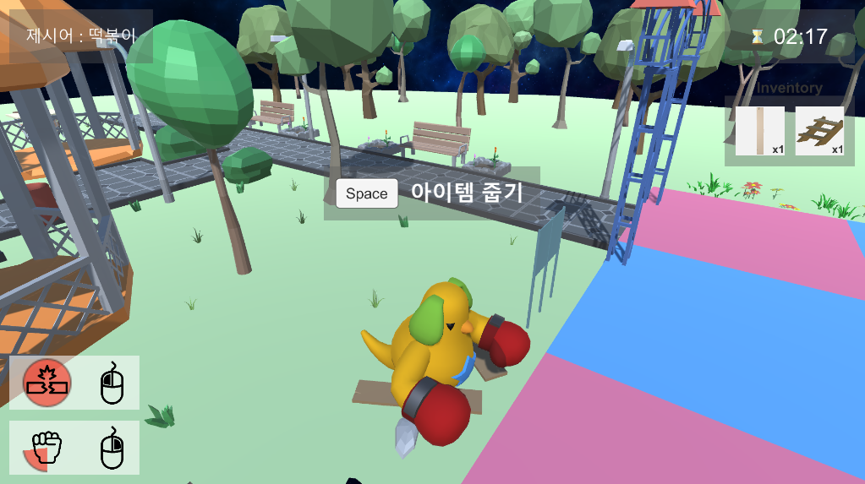
1
Game Introduction
1-4. Collecting Time
You can collect items for 3 minutes.
If you destroy any object on the map, it will drop items.
Item | Content
1 | Word
2 | Skills
3 | Pop-up: Press E to get item
4 | Time limit
5 | Inventory
4
1
3
5
2

Slide 10
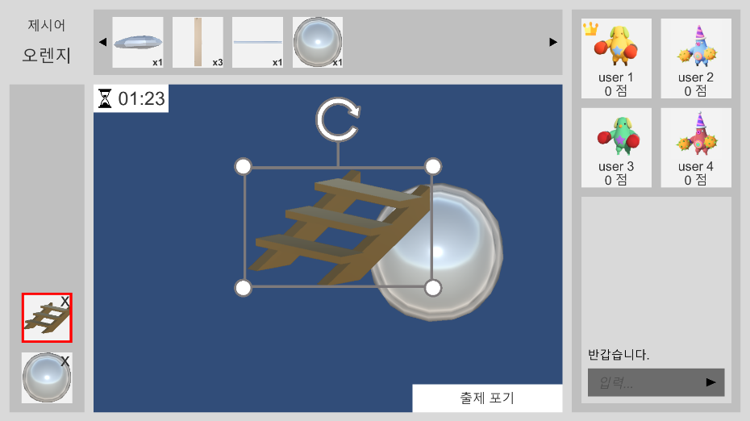
1
Game Introduction
1-5. Quiz Time
You can put the items in your inventory on the canvas.
Describe the word you have to other players.
Item | Content
1 | Inventory
2 | ‘Items on canvas’ list
3 | Item interaction
4 | Give up button
5 | Chat
1
5
3
2
4

Slide 11




2
Development
2-1. Team Introduction
김나영
박지윤
Game Design
Getting Resource
Map Making
Speech
Main Game Producing
(Collecting Item)
정상민
최주희
Inventory System
Quiz Time
Main Idea Provid
Title Design
Network

Slide 12
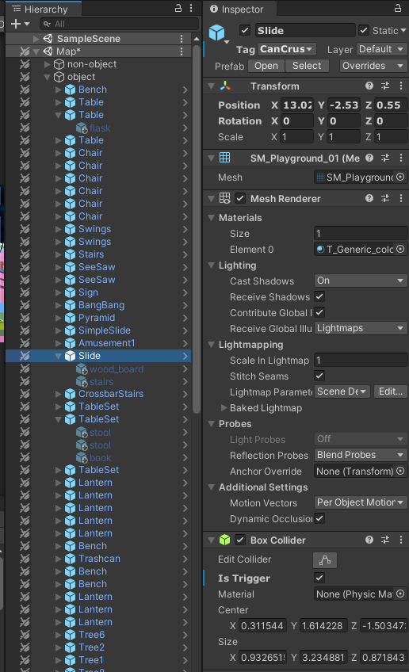
2
Development
2-2. Collecting Time
Punch(Knock another player down)
When the player right-clicks
Using Input.GetMouseButtonDown(1) Senses the right-clicks
If right-clicks is true -> animation(Attack01) turn true + Start cool time
If right-clicks is false -> animation(Attack01) turn false
Kick(Destroy objects on the map)
When the player left-clicks
Using Input.GetMouseButtonDown(0) Senses the left-clicks
If left-clicks is true -> animation(Attack02) turn true + Start cool time
+ (If Object collider is OnTriggerStay with player collider)Destroy object on the map
If left-clicks is false -> animation(Attack02) turn false
When the object is destroyed, the sub-object which player can use at quiz-time are Appear
The object which can destroyed, all of these have some child-object that appear when it be destroyed

Slide 13
2
Development
2-2. Collecting Time
Player move
Player move get character rigidbody, to fine out and control the position of the character.
We Update the character position in every frame. And that new position was determined by key Input.
Also put the Speed of the moving, multiply to the Vector of the character position, also multiply the Time.deltaTime for imply the speed.
If the key that moves the player is recognized, Let the Walking animation activate. If not, deactivate.
Let the camera rotate with the center of character use mouse moving.
Pick Up (Store in inventory)
All the item that can be stored are tagged by ‘item’ and they have collider which can detect with the player.
If player and item are OnTriggerStay (touching each other), the pop-up for pick up will appear, and player use key ‘Space Bar’ can pick up that item.
When player key down the space bar in the right timing, the item will move to inventory.

Slide 14
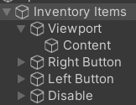
2
Development
2-3. Quiz Time
Inventory
The class that manages the *information of items (ex. *information = number, name, code)
Private Dictionary<int, int> itemCount; //key=Code, Value=number of Item
Private Dictionary<int, string> Lookup; //key=Code, Value=name of Item
Case 1 : the number of items increases ➔ itemCount[item.code] += 1
(1) When the player gets Items in Main Stage Map
(2) When the player deletes Drawn Items in Quiz Time(= when ‘x button‘ onClick event occurs)
Case 2 : the number of items decreases ➔ itemCount[item.code] -= 1
(1) When player clicks ‘Inventory Item’ (= when ‘item button’ onClick event occurs)
(2) Inventory Items
The class that shows the number/name of items in ‘Inventory Manager’
Inventory Item becomes child-object of Content.
When the player clicks ‘Inventory Item’ Button in Quiz Time
➔ OnClickItem runs
➔ And then, ‘Drawn Item’ is shown in ‘Drawn Items’
public void OnClickItem(int code){
SelectItem(code);
drawnItems.DrawItem(code);
}

Slide 15
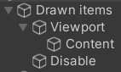
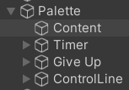
2
Development
2-3. Quiz Time
(3) Drawn Items
The class that shows the drawn items
Drawn Item becomes child-object of Content.
When the player clicks ‘Inventory Item’ Button in Quiz Time,
Drawn Item is added in Drawn Items, Palette Item is also added in Palette.
‘Inventor Item’ button click ➔ Inventory Items Manager runs OnClickItem ➔ drawnItems.DrawItem(code) ➔ palette.DrawObject(id, code);
(4) Palette
The class that manages the palette items and control line.
Palette Item/Control line become child-object of Content.
The ‘draw item’ is added
➔ The ‘pallet item’ is placed in the center of the Palette
(newObject.transform.position = newControl.GetPosition(); )
➔ The control line is activated. (newControl.Draw(); )
If Inventory/Drawn/Palette Item are clicked
➔ Control Line is activated by running SelectObject function. ( idToControl[id].Draw(); )
➔ Clicked Drawn Item activates selection sign. (drawnItems.SelectObject(id); )
public void SelectObject(int id){
InitializeSelection();
idToControl[id].Draw();//Control Line is activated
drawnItems.InitializeSelection();
drawnItems.SelectObject(id);
selectedID = id;
}

Slide 16
2
Development
2-4. Network
Character creation was implemented through PhotonNetwork. Instantiate in ‘GameManager’. And animation, location, and rotation were all synchronized through PhotonView and PhotonTransformView. In the process of disappearing objects like items, they were’ handled ‘destroy by using RPC and because it is to create a prefab, all variables were newly found using GameObject. Find function.
Because UI is not created in each client with PhotonNetwork. Instantiate, it was implemented in ‘Palette Manager’ by adding the prefab for the network.

Slide 17

3
Game Video
3-1. Play Video

Slide 18
THANK YOU!
감사합니다!
Github Link :

